Slide 1

Kaff Platform
Group 3
Jumana, Sumaiyah, Mariam, Zaina, Duaa, and Latifa

Slide 2
What is Kaff Platform?

Slide 3
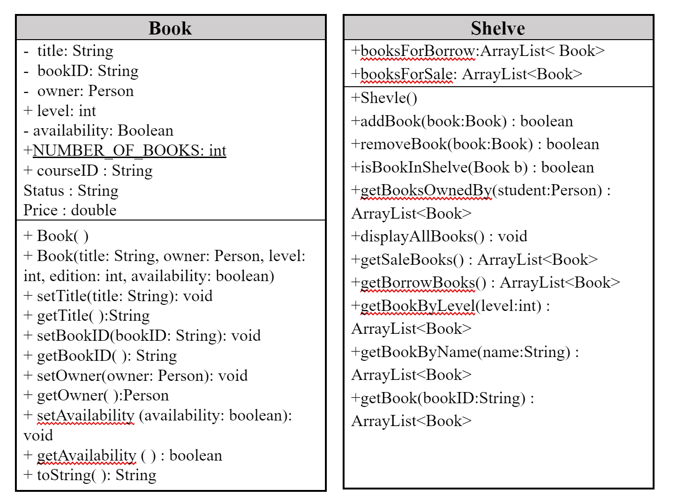
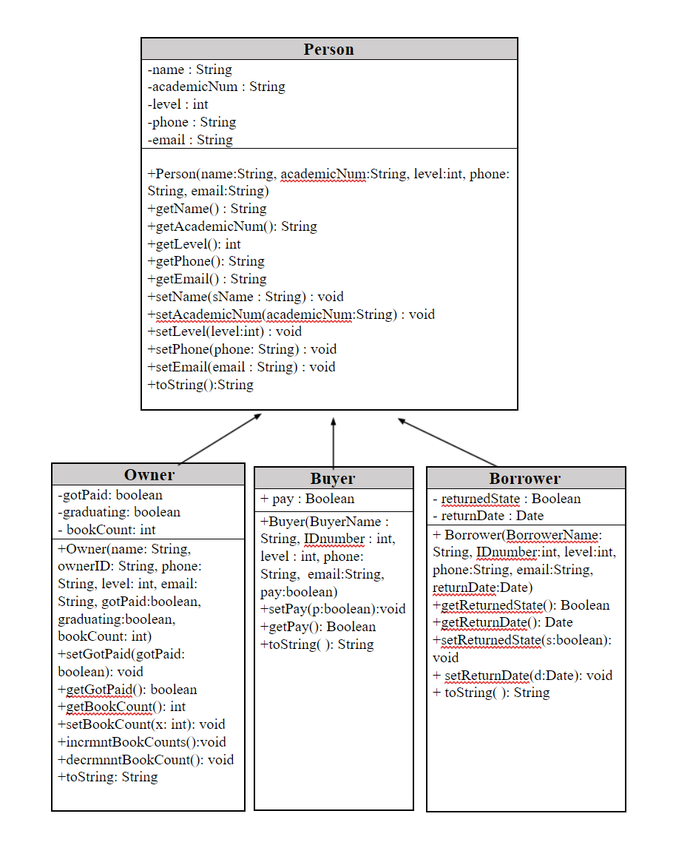

Slide 4
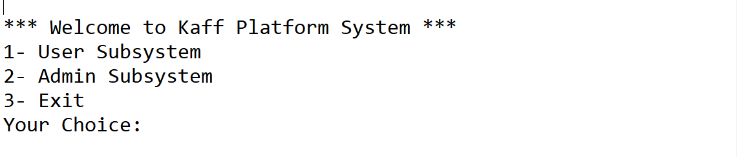
Methods in the main - Sumaya’s Part :
The system is running and the first menu is displayed.

Slide 5
Methods & Variables
Start main method
import java.util.*;
public class KaffPlatformSystem {
static String main_menu = "\n*** Welcome to Kaff Platform System ***\n" + "1- User Subsystem\n"
+ "2- Admin Subsystem\n" + "3- Exit \n" + "Your Choice: ";
static String user_menu = "\n\t*** Welcome to User Sub-system ***\n" + "\t1- Add a book \n" + "\t2- Buy a book \n"
+ "\t3- Borrow a book \n" + "\t4- Return a book \n" + "\t5- Display books \n"
+ "\t6- Update your information \n" + "\t7- Exit/Change User \n" + "\tYour Choice: ";
static String admin_menu = "\n\t*** Welcome to Admin Sub-system ***\n" + "\t1- Recieved money \n"
+ "\t2- Remove a book \n" + "\t3- Display books owned by a user\n" + "\t4- Print balance \n"
+ "\t5- Update book information \n" + "\t6- Display users \n" + "\t7- Exit \n" + "\tYour Choice: ";;
static Scanner input = new Scanner(System.in);
static ArrayList<Person> user = new ArrayList<>();
static Shelve shelve = new Shelve();
static double balance = 0;
static int noOfUsers = 0;
static Book book;
static String name, userId, phone, email;
static int userLvl;
public static void main(String[] args) {
int choice = 0;
fillShelve();
do {
System.out.print(main_menu);
choice = input.nextInt();
switch (choice) {
case 1:
user_system();
break;
case 2:
admin_system();
break;
case 3:
break;
default:
System.out.print("Wrong Entry. Please enter a valid option.");
}
} while (choice != 3);
System.out.println("Thank you for using our system, may the books be in your favor:)!");
}
static void user_system() {
noOfUsers++;
int currentOwner = -1;
int currentBuyer = -1;
int currentBorrower = -1;
getUserInformation();
boolean flagOwner = false;
boolean flagBuyer = false;
boolean flagBorrower = false;

Slide 6
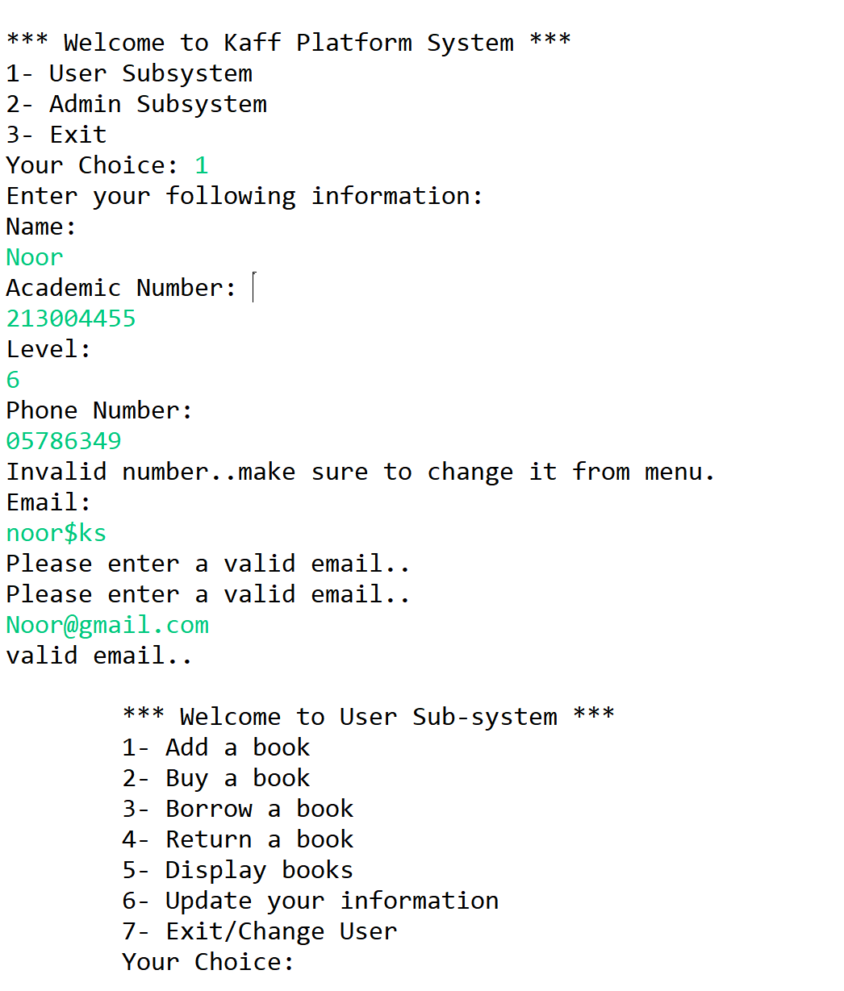
A user information is saved while error handling different user inputs.

Slide 7
First case in the user system:
int choice;
do {
System.out.print(user_menu);
choice = input.nextInt();
switch (choice) {
case 1: {
// Add a book
if (!flagOwner) {
// checks if owner object is created for this person
// before..
for (int i = 0; i < getOwners(user).size(); i++)
if (((getOwners(user)).get(i).getAcademicNum()).equals(userId))
flagOwner = true;
}
if (!flagOwner) {
// creates a new owner object for the user..
System.out.println("Are you graduating this year? (y/n)");
do {
String g = input.next();
if (g.equalsIgnoreCase("y")) {
user.add(new Owner(name, userId, userLvl, phone, email, false, true, 0));
currentOwner = (user.size()) - 1;
break;
} else if (g.equalsIgnoreCase("n")) {
user.add(new Owner(name, userId, userLvl, phone, email, false, false, 0));
currentOwner = (user.size()) - 1;
break;
} else
System.out.print("Wrong entry. Please enter either y/n.");
} while (true);
}

Slide 8
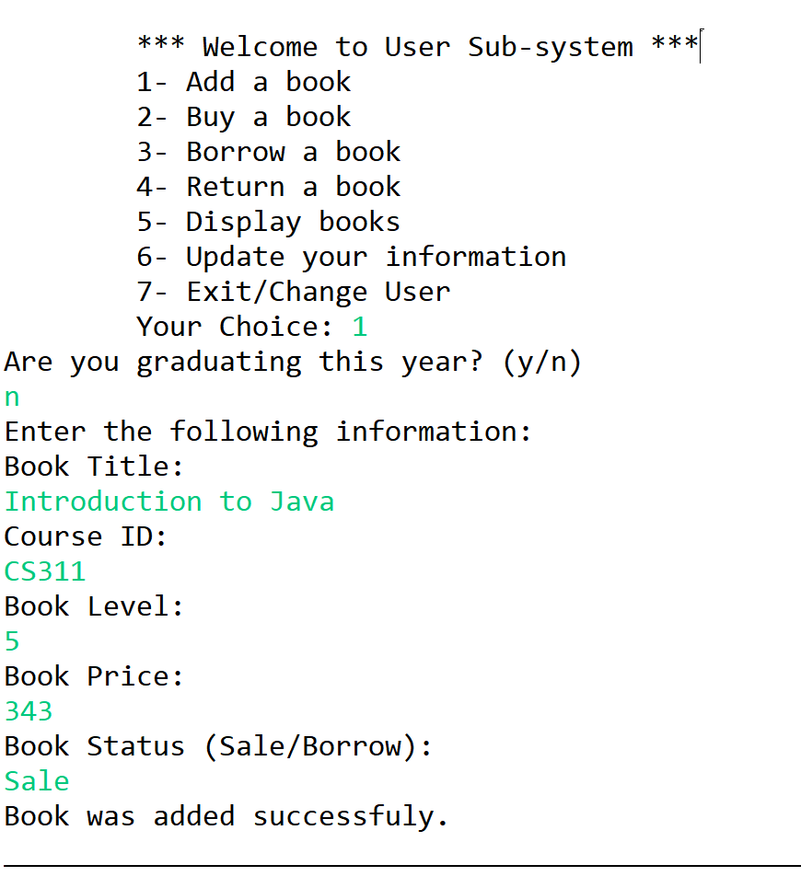
// get information for the book..
System.out.println("Enter the following information:");
System.out.println("Book Title:");
String title = input.nextLine();
title = input.nextLine();
System.out.println("Course ID:");
String id = input.nextLine();
System.out.println("Book Level:");
int lvl = input.nextInt();
do {
if (lvl>=1 && lvl<=10)
break;
else
{System.out.print("Level must be between 0-10.. Enter level again:");
lvl = input.nextInt();
}
}while(true);
System.out.println("Book Price:");
double prc = input.nextDouble();
do {
if (prc>=0 && prc<=500)
break;
else
{System.out.print("Book Price must be between 0-500 SR.. Enter price again:");
prc = input.nextInt();
}
}while(true);
System.out.println("Book Status (Sale/Borrow):");
String s = input.next();
do {
if (s.equalsIgnoreCase("sale") || s.equalsIgnoreCase("borrow"))
break;
else
{System.out.print("Please enter either (sale/borrow)");
s = input.next();
}
}while(true);
// create the book object then add in the shelve
Book b = new Book(title, id, lvl, user.get(currentOwner), true, prc, s);
if (shelve.addBook(b))
{
System.out.println("Book was added successfuly.");
((Owner) user.get(currentOwner)).incrmntBookCount();
}
else
System.out.println("Book was not added successfuly, it seems there's a kind of error.");
line();
break;
}

Slide 9
Methods in the main - Doaa’s Part :
Case 2 (buy book):
case 2: {
// 2- buy book
Book book = getTheBook();
if (book != null) {
System.out.println("The book price is: " + book.getPrice());
// checks if the user is a buyer or create a buyer object
if (!flagBuyer)
for (int i = 0; i < getBuyers(user).size(); i++)
if (((getBuyers(user)).get(i).getAcademicNum()).equals(userId)) { flagBuyer = true;
break; }
if (!flagBuyer) {
user.add(new Buyer(name, userId, userLvl, phone, email, true));
currentBuyer = (user.size()) - 1; }
// book is bought..
book.setAvailability(false);
System.out.print(book + "\nYou have bought this book.");
balance += book.getPrice(); }
line();
break; }

Slide 10
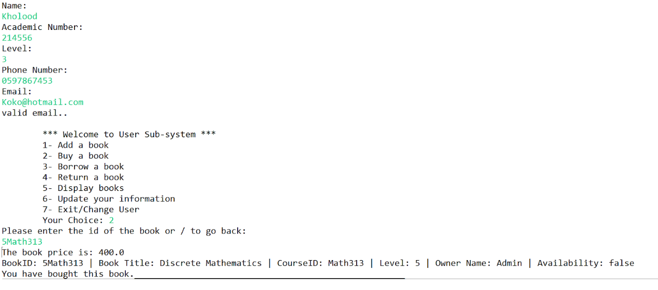

Slide 11
Case 3 ( borrow book ):
if (!flagBorrower) {
for (int i = 0; i < getBorrowers(user).size(); i++)
if (((getBorrowers(user)).get(i).getAcademicNum()).equals(userId))
flagBorrower = true;
}
if (!flagBorrower) {
user.add(new Borrower(name, userId, userLvl, phone, email, new Date()));
currentOwner = (user.size()) - 1;
}
// ask which book he wants to borrow
book = getTheBook();
if (book != null) {
if (book.getAvailability())
System.out.println(book + " is avaiable to borrow.");
else
System.out.println(book + " is not avaiable..");
book.setAvailability(false);
}}

Slide 12
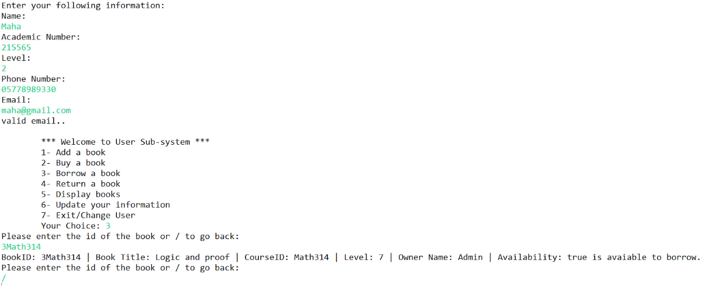

Slide 13
Case 4 ( return a book ):
case 4: {
book = getTheBook();
if (book != null) {
System.out.println("Thank you for returning the book.");
book.setAvailability(true);
}
break;

Slide 14
Asks user for the book id and returns the book:
static public Book getTheBook() {
Book book = null;
do {
System.out.println("Please enter the id of the book or / to go back:");
String bookID = input.next();
if (bookID.equals("/"))
break;
book = shelve.getBook(bookID);
if (book == null)
System.out.println("The book ID is not available.");
} while (book == null);
return book;
}

Slide 15
Get Book:
Got Borrower:
public Book getBook(String bookID){
//look in booksForBorrow
for(int i = 0; i < booksForBorrow.size(); i++){
if(bookID.equalsIgnoreCase(booksForBorrow.get(i).getBookID()))
return booksForBorrow.get(i);
}
for(int i = 0; i < booksForSale.size(); i++){
if(bookID.equalsIgnoreCase(booksForSale.get(i).getBookID()))
return booksForSale.get(i);
}
return null;
}
static public ArrayList<Borrower> getBorrowers(ArrayList<Person> user) {
ArrayList<Borrower> borrower = new ArrayList<>();
for (int i = 0; i < user.size(); i++)
if (user.get(i) instanceof Borrower)
borrower.add((Borrower) user.get(i));
return borrower; }
Got Buyer:
static public ArrayList<Buyer> getBuyers(ArrayList<Person> user) {
ArrayList<Buyer> buyer = new ArrayList<>();
for (int i = 0; i < user.size(); i++)
if (user.get(i) instanceof Buyer)
buyer.add((Buyer) user.get(i));
return buyer;}

Slide 16
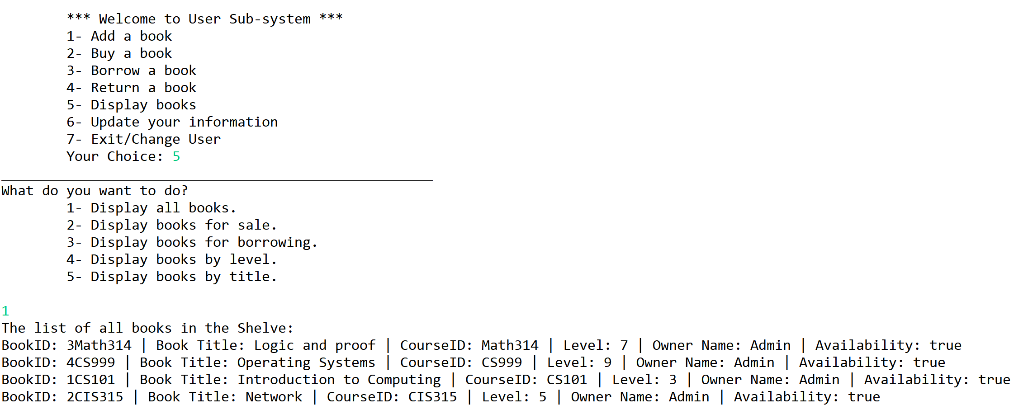
Methods in the main - Zainah’s Part :
case 5: {
// Display books
line();
System.out.println("What do you want to do? \n" + "\t1- Display all books. \n"
+ "\t2- Display books for sale. \n" + "\t3- Display books for borrowing. \n"
+ "\t4- Display books by level. \n" + "\t5- Display books by title. \n");
int c = input.nextInt();
switch (c) {
case 1:
shelve.displayAllBooks();
break;
case 2:
printList(shelve.getBooksForSale());
break;
case 3:
printList(shelve.getBooksForBorrow());
break;
case 4:
System.out.print("Choose the level from 1 to 10:");
int level = input.nextInt();
printList(shelve.getBooksByLevel(level));
break;
case 5:
System.out.print("Enter the book title:");
String title = input.nextLine();
title = input.nextLine();
printList(shelve.getBooksByName(title));
break;
default:
System.out.println("Invalid entry.");
line();
}
break; }
private static void printList(ArrayList<Book> list) {
for (Book b : list)
System.out.println(b);
}
Display of all books before user adding any book

Slide 17
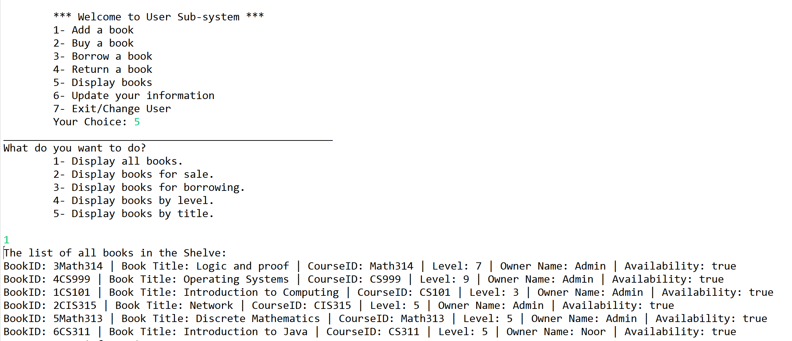
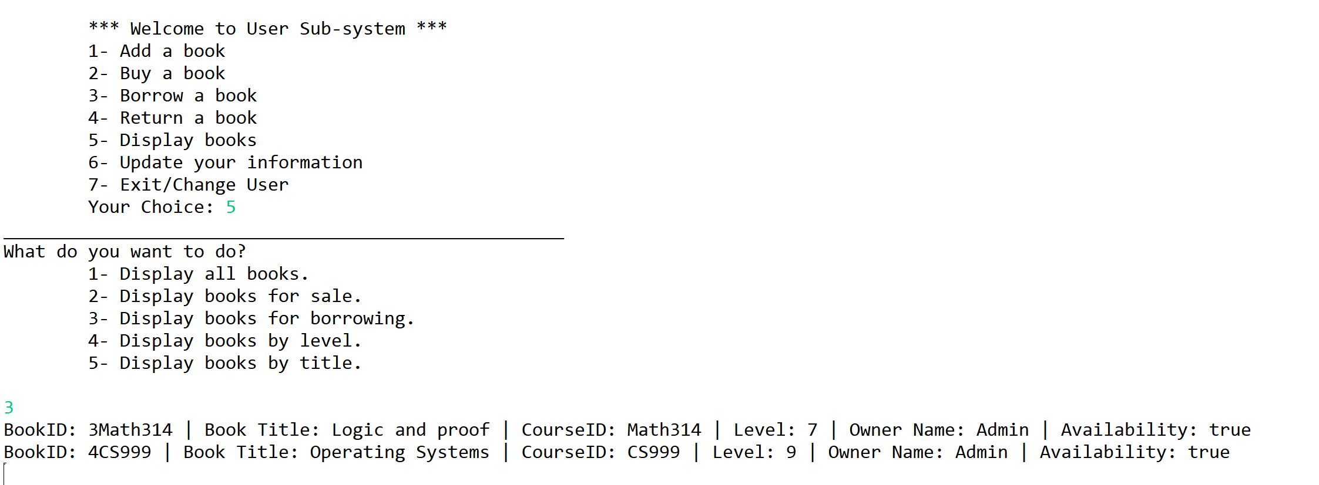
Display of all books after user addition.
Display books for Borrow.

Slide 18
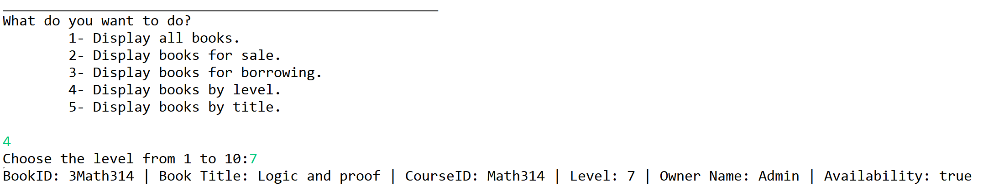
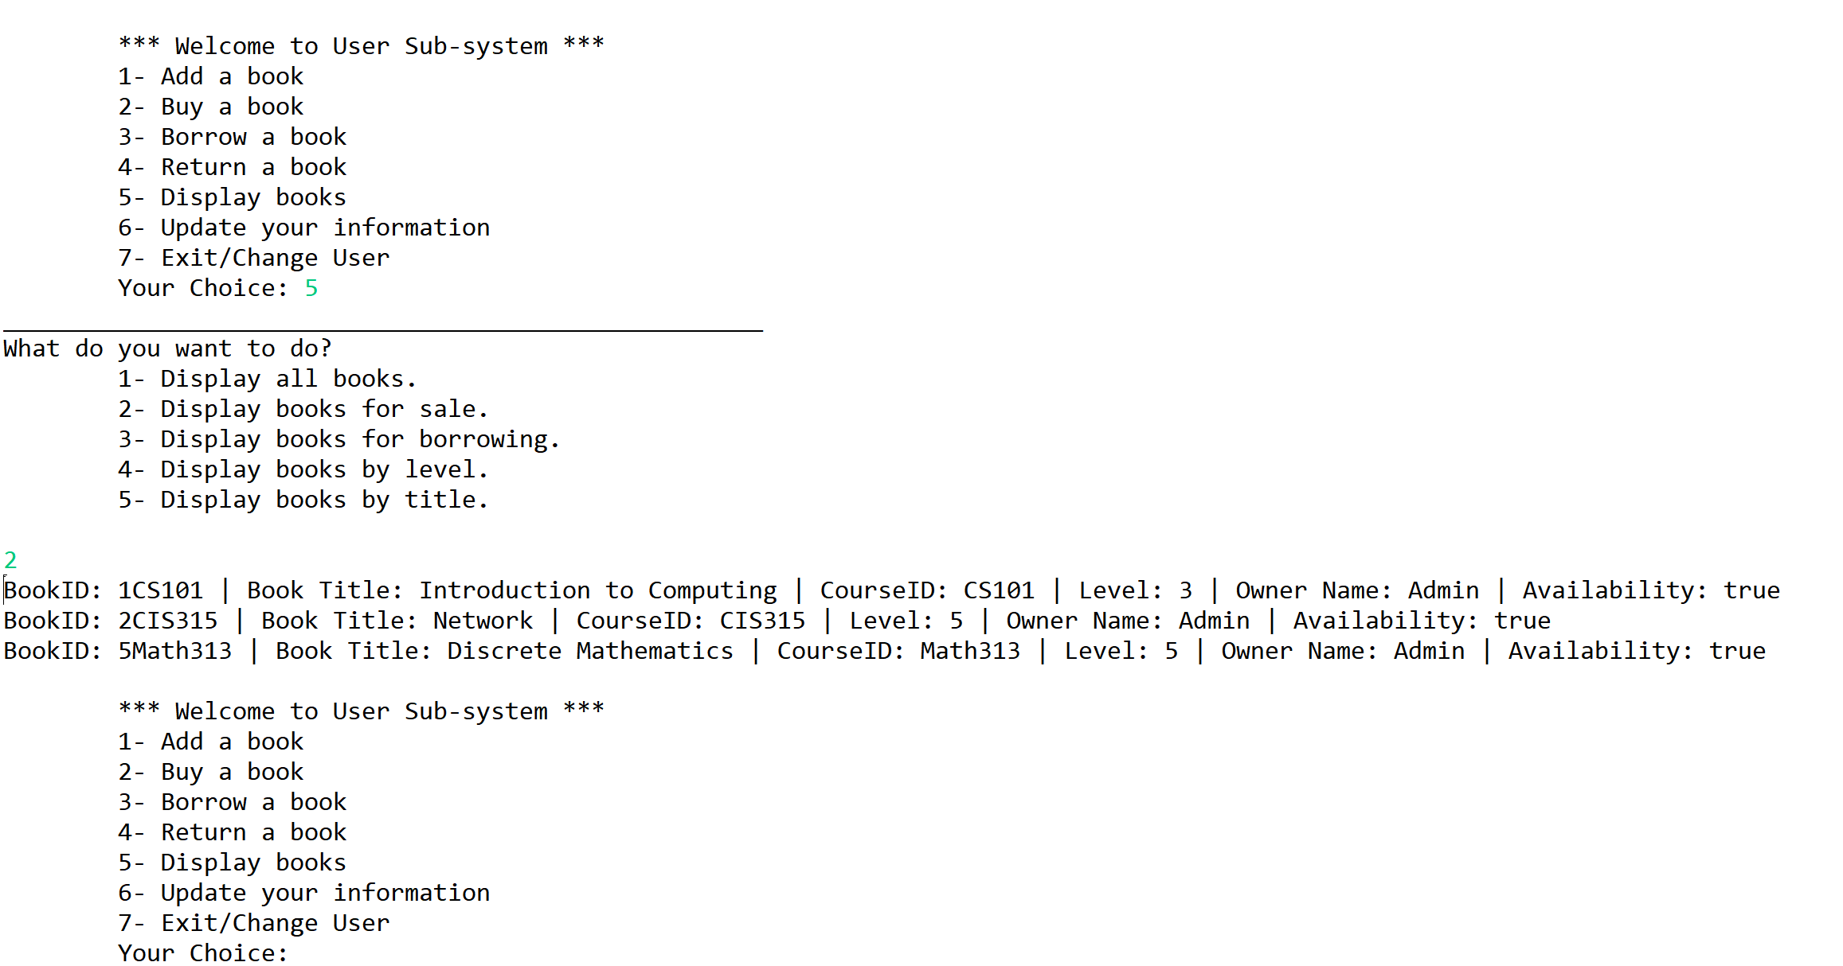
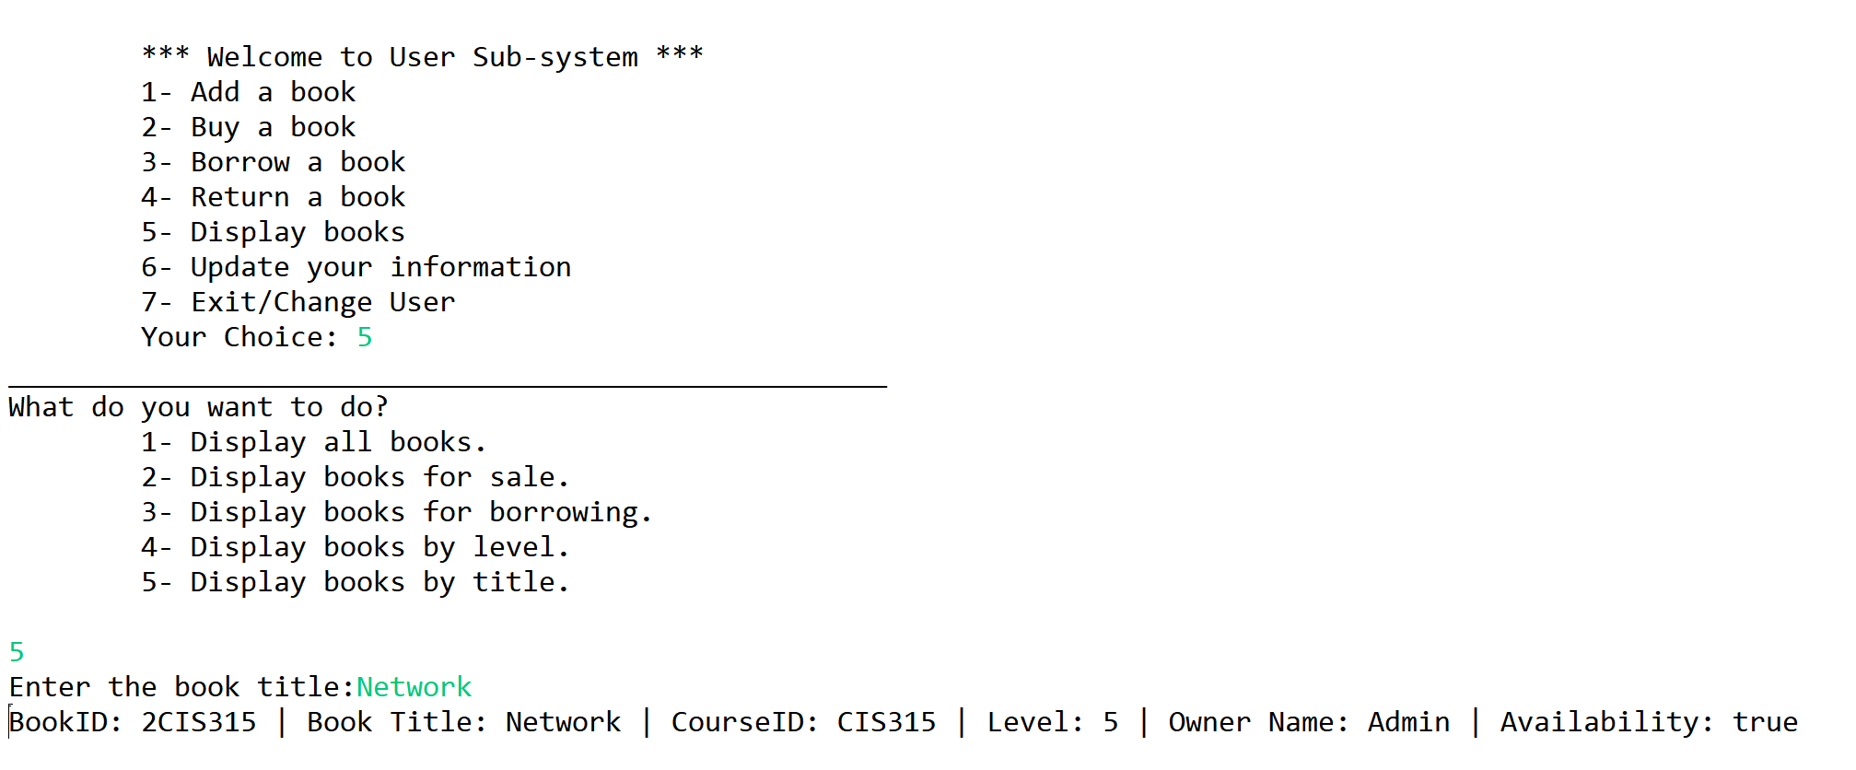
Display books for Sale.
Display books based on title, and based on level for the book.

Slide 19
A user decides to update her information, in this sample the phone number is changed.
switch (c) {
case 1:
System.out.println("Enter your new phone number:");
phone = input.next();
boolean flag=true;
do {
for (int i = 0; i < phone.length(); i++)
if (!Character.isDigit(phone.charAt(i)))
{flag=false;
break;}
if (phone.length() == 10 && flag)
break;
else
{System.out.println("Phone number must be 10 digits.. Please enter it again");
phone = input.nextLine();
flag=true;
}
}while (true);
if (currentOwner != -1)
user.get(currentOwner).setPhone(phone);
if (currentBuyer != -1)
user.get(currentOwner).setPhone(phone);
if (currentBorrower != -1)
user.get(currentOwner).setPhone(phone);
break;
case 6: {
// Update your info
System.out.println("Your current information are:\n" + "Name| " + name + " ID| " + userId + " Level| "
+ userLvl + " Phone number| " + phone + " Email| " + email);
System.out.print("What do you want to update:\n" + "\t1-Phone Number\n" + "\t2-Email\n" + "\t3-Level");
int c = input.nextInt();

Slide 20
A user decides to update her information, in this sample the phone number is changed.
case 3:
System.out.println("Enter your new level");
userLvl = input.nextInt();
do {
if (userLvl > 10 || userLvl < 1) {
System.out.println("Must be between 1 and 10...Please enter a valid number..");
userLvl = input.nextInt();
} else
break;
} while (true);
if (currentOwner != -1)
user.get(currentOwner).setLevel(userLvl);
if (currentBuyer != -1)
user.get(currentOwner).setLevel(userLvl);
if (currentBorrower != -1)
user.get(currentOwner).setLevel(userLvl);
break;
default:
System.out.print("Invalid entry.");
}
break;
}
case 2:
System.out.println("Enter your new email address");
email = input.next();
do {
if (email.contains("@") && email.contains(".")) {
System.out.println("valid email..");
break;
} else {
System.out.println("Please enter a valid email..");
email = input.next();
}
} while (true);
if (currentOwner != -1)
user.get(currentOwner).setEmail(email);
if (currentBuyer != -1)
user.get(currentOwner).setEmail(email);
if (currentBorrower != -1)
user.get(currentOwner).setEmail(email);
break;

Slide 21
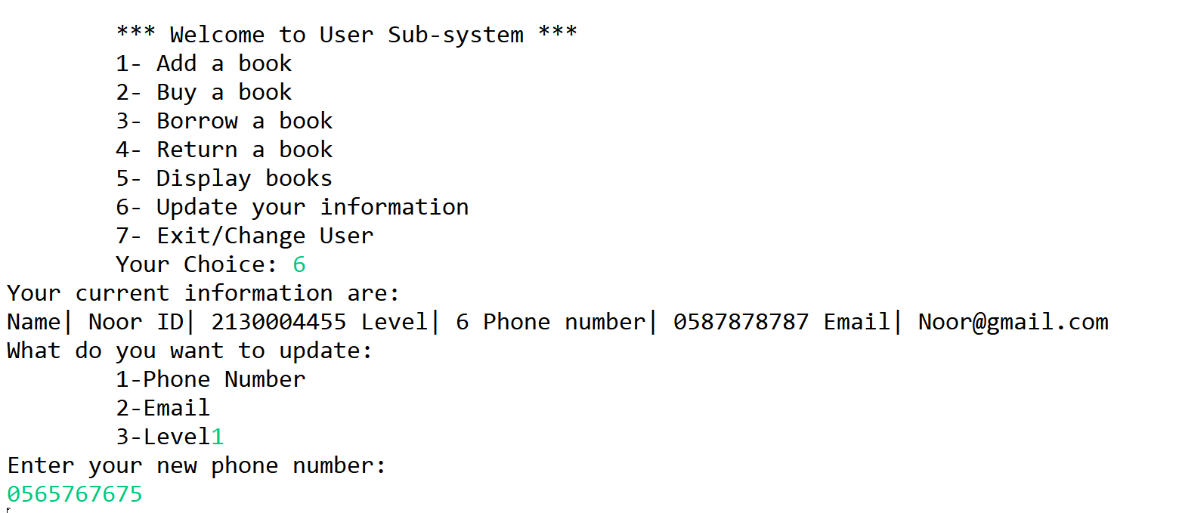
A user decides to update her information, in this sample the phone number is changed

Slide 22
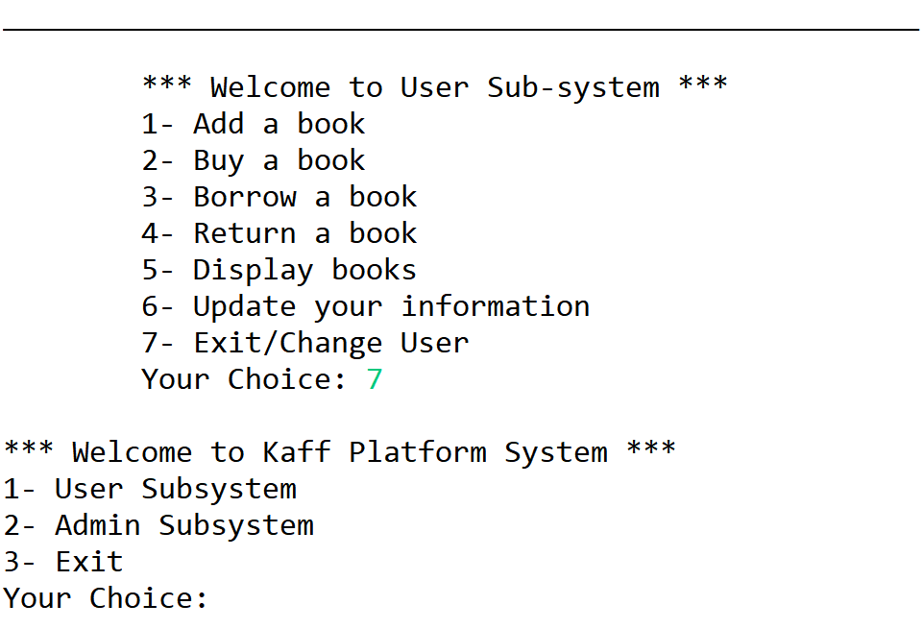
The user exited the Sub-System
case 7:
break;
default:
System.out.println("Wrong entry. Please choose from the list provided :)!");
line();
}
} while (choice != 7);
}

Slide 23
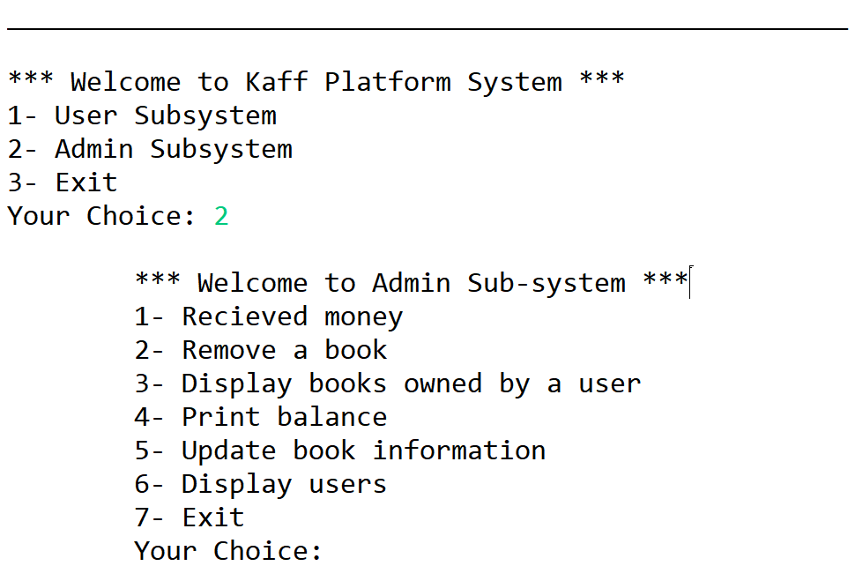
Methods in the main - Latifa’s Part :
Static void admin_system() {
int choice;
do {
System.out.print(admin_menu);
choice = input.nextInt();

Slide 24
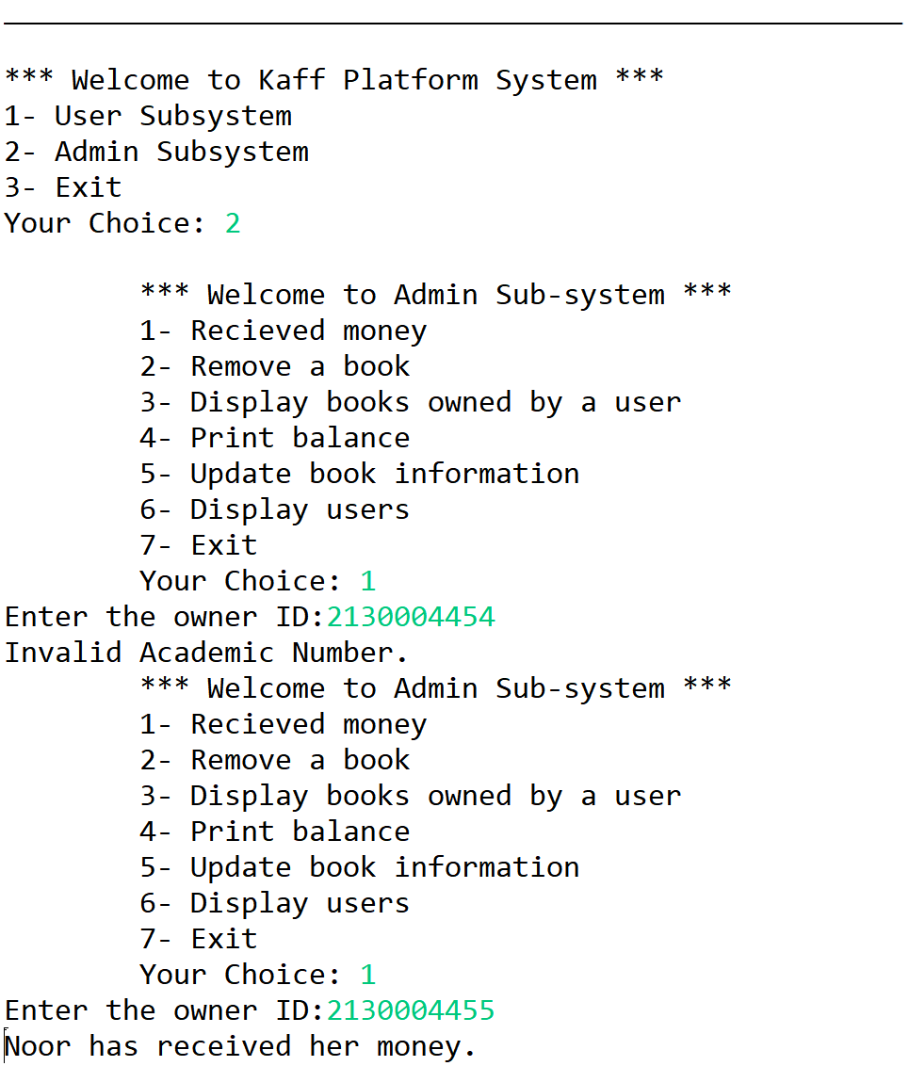
Case 1 : Received money
// Received money
System.out.print("Enter the owner ID:");
String ownerId = input.next();
boolean flag = false;
for (int i = 0; i < getOwners(user).size(); i++)
if (((getOwners(user)).get(i).getAcademicNum()).equals(ownerId)) {
(getOwners(user)).get(i).setGotPaid(true);
System.out.print(getOwners(user).get(i).getName() + " has received her money.");
flag = true;ه
break; }
if (!flag) {
System.out.print("Invalid Academic Number.");
break;

Slide 25
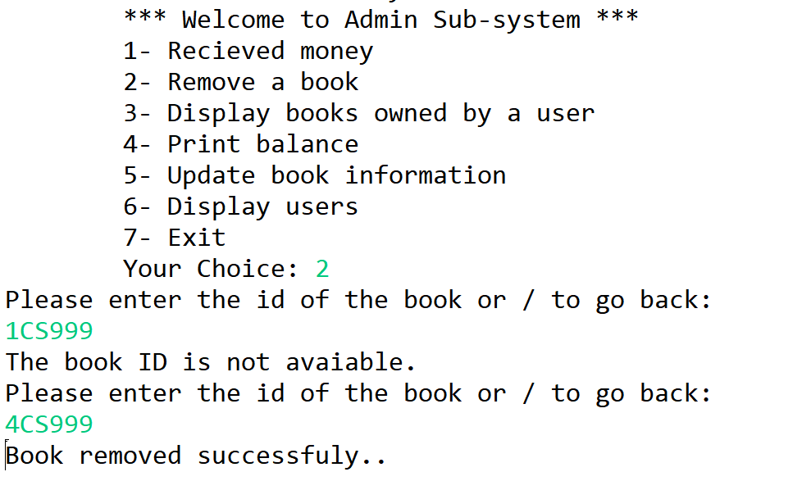
Case 2: Remove book
// reremove book
Book book = getTheBook();
if (book != null && shelve.removeBook(book))
System.out.println("Book removed successfuly..");
else
System.out.println
("Ops.. Some error maybe wrong bookID entered.");

Slide 26
Case 3: Display book owned by user
// display book owned by user
System.out.println("Please enter user academic id number: ");
String id = input.next();
Person p;
if (isIDInList(id)) {
p = getUser(id);
if (p instanceof Owner)
printList(shelve.getBooksOwnedBy(p));
} else
System.out.println("Invalid ID number...:(");
break;

Slide 27
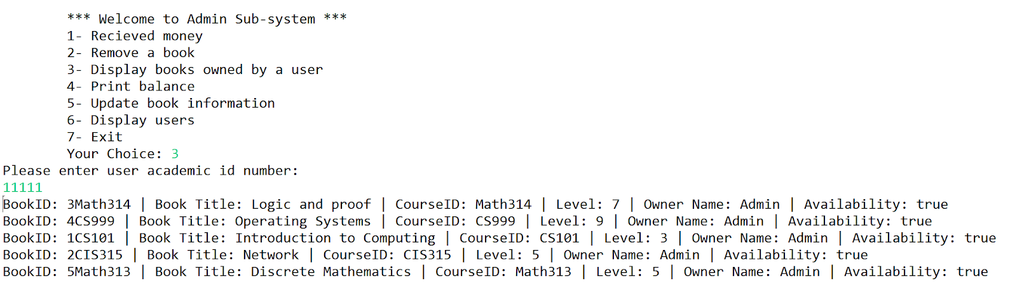

Slide 28
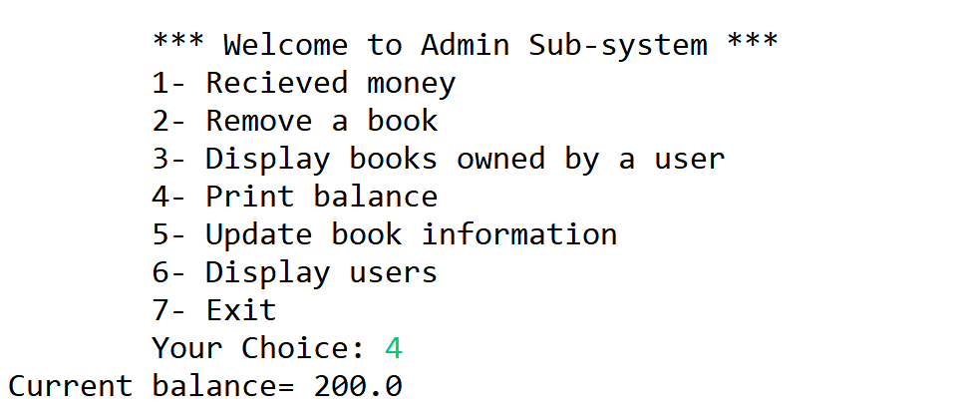
Case 4: Display the current balance
Case 4:
System.out.println("Current balance= " + balance);
break;

Slide 29
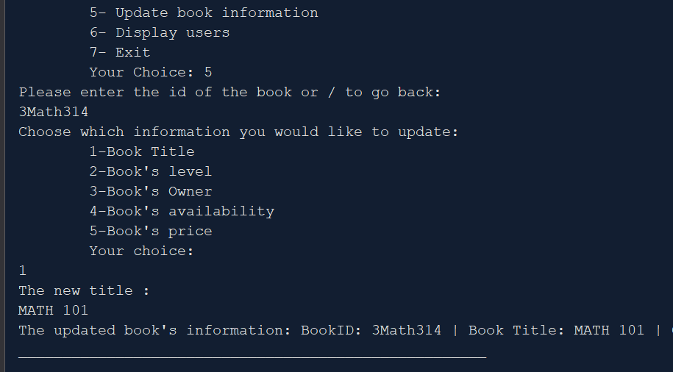
Methods in the main - Maryam’s Part
int choice;
do {
System.out.print(admin_menu);
choice = input.nextInt();
switch (choice) {
case 5:
// update book info
book = getTheBook();
if (book != null) {
System.out.println("Choose which information you would like to update:“
+ "\n\t1-Book Title" + "\n\t2-Book's level" + "\n\t3-Book's Owner" + "\n\t4-Book’s availability"+ "\n\t5-Book's price"
+ "\n\tYour choice: ");
choice = input.nextInt();
switch (choice) {
// change title
case 1:
System.out.println("The new title : ");
String title =input.nextLine();
title =input.nextLine();
book.setTitle(title);
break;

Slide 30
// change level
case 2:
int lv;
do{
System.out.println("The new level (choose from 1 to 10 levels): ");
lv = input.nextInt();
if ((lv <= 10)&&(lv >= 0)){
book.setLevel(lv);
break;}
else
System.out.println("Ooops .. invalid level !!");
}while(true);
break;
Choose which information you would like to update:
1-Book Title
2-Book's level
3-Book's Owner
4-Book's availability
5-Book's price
Your choice:
2
The new level (choose from 1 to 10 levels):
5
The updated book's information: BookID: 3Math314 | Book Title: MATH 101 | CourseID: Math314 | Level: 5 | Owner Name: Admin2 | Availability: true

Slide 31
// change owner
case 3:
String yesORno;
do{
System.out.println("Is prevouse owner ? (yes/no)");
yesORno = input.next();
if((yesORno.equalsIgnoreCase("yes")) ||(yesORno.equalsIgnoreCase("no")) ){
if (yesORno.equalsIgnoreCase("yes")) {
boolean isHeHere;
do {
System.out.println("Please enter user academic id number: ");
String oid = input.next();
isHeHere = isIDInList(oid);
if (isHeHere) {
book.setOwner(getUser(oid));
}else {
System.out.println("Oooops .. must ID is wrong !!");
}
} while (!isHeHere);
break;
}
else if (yesORno.equalsIgnoreCase("no")) {
getUserInformation();
user.add(new Person(name, userId, userLvl, phone, email));
book.setOwner(user.get(user.size() - 1));
break;}}
else
System.out.println("Ooops .. invalid input !!");
}while(true);
break;
Choose which information you would like to update:
1-Book Title
2-Book's level
3-Book's Owner
4-Book's availability
5-Book's price
Your choice:
3
Is previous owner ? (yes/no)
yes
Please enter user academic id number:
11122
The updated book's information: BookID: 3Math314 | Book Title: MATH 101 | CourseID: Math314 | Level: 5 | Owner Name: Admin2 | Availability: true

Slide 32
Choose which information you would like to update:
1-Book Title
2-Book's level
3-Book's Owner
4-Book's availability
5-Book's price
Your choice:
3
Is prevouse owner ? (yes/no)
no
Enter your following information:
Name:
maryam
Academic Number:
217008191
Level:
5
Phone Number:
0553277684
Email:
mema@gmail.com
valid email..
The updated book's information: BookID: 3Math314 | Book Title: MATH 101 | CourseID: Math314 | Level: 5 | Owner Name: maryam | Availability: truex
// change owner
case 3:
String yesORno;
do{
System.out.println("Is prevouse owner ? (yes/no)");
yesORno = input.next();
if((yesORno.equalsIgnoreCase("yes")) ||(yesORno.equalsIgnoreCase("no")) ){
if (yesORno.equalsIgnoreCase("yes")) {
boolean isHeHere;
do {
System.out.println("Please enter user academic id number: ");
String oid = input.next();
isHeHere = isIDInList(oid);
if (isHeHere) {
book.setOwner(getUser(oid));
}else {
System.out.println("Oooops .. must ID is wrong !!");
}
} while (!isHeHere);
break;
}
else if (yesORno.equalsIgnoreCase("no")) {
getUserInformation();
user.add(new Person(name, userId, userLvl, phone, email));
book.setOwner(user.get(user.size() - 1));
break;}}
else
System.out.println("Ooops .. invalid input !!");
}while(true);
break;

Slide 33
Choose which information you would like to update:
1-Book Title
2-Book's level
3-Book's Owner
4-Book's availability
5-Book's price
Your choice:
4
IS it available ? (yes/no)
no
The updated book's information: BookID: 3Math314 | Book Title: MATH 101 | CourseID: Math314 | Level: 5 | Owner Name: maryam | Availability: false
// change Availability
case 4:
String available;
do{
System.out.println("IS it available ? (yes/no)");
available = input.next();
if((available.equalsIgnoreCase("yes")) ||(available.equalsIgnoreCase("no")) ){
if (available.equalsIgnoreCase("yes")) {
book.setAvailability(true);
break;
} else if (available.equalsIgnoreCase("no")) {
book.setAvailability(false);
break;
}}
else
System.out.println("Ooops .. invalid input !!");
}while(true);
break;
// change price
case 5:
System.out.println("The new price : ");
int prc = input.nextInt();
book.setPrice(prc);
break;
}
System.out.println("The updated book's information: " + book);
line();
}
break;
Choose which information you would like to update:
1-Book Title
2-Book's level
3-Book's Owner
4-Book's availability
5-Book's price
Your choice:
5
The new price :
500

Slide 34
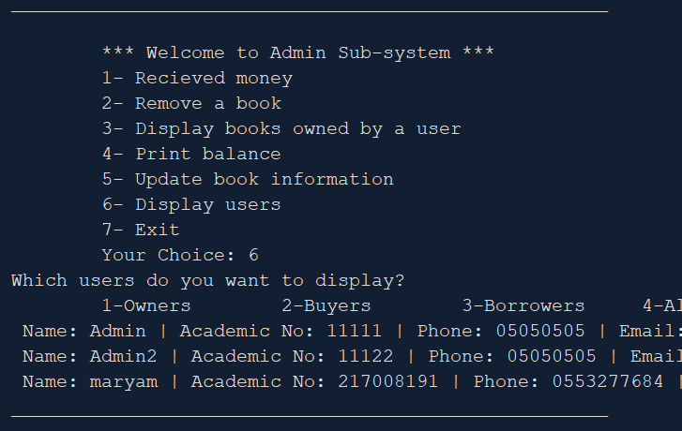
case 6:
// display users information
System.out.print("Which users do you want to display?\n" + "\t1-Owners" + "\t2-Buyers" + "\t3-Borrowers"
+ "\t4-All users");
int c = input.nextInt();
switch (c) {
case 1:
for (Owner o : getOwners(user))
System.out.println(o);
break;
case 2:
for (Buyer b : getBuyers(user))
System.out.println(b);
break;
case 3:
for (Borrower w : getBorrowers(user))
System.out.println(w);
break;
case 4:
for (Person per : user)
System.out.println(per);
break;
default:
System.out.println("Invalid entry.");
}
} while (choice != 7);

Slide 35
Methods in the main - Jumana’s Part

